Slide 1

Vision AI: Image Recognition in 5 Days
Build an image classification system from scratch and optimize it using transfer learning

Slide 2
Methodology
Key Features
Day 1 – Dataset Preprocessing & Visualization (MNIST)
Day 2 – Baseline CNN Model (MNIST)
Day 3 – Data Augmentation & Evaluation (CIFAR-10)
Day 4 – Transfer Learning with MobileNetV2 (Cats vs Dogs)
Day 5 – Deployment with Gradio UI
End-to-end ML pipeline
Real-time classification web UI
Transfer learning for performance boost
Multi-dataset exposure
Clean, reproducible code

Slide 3
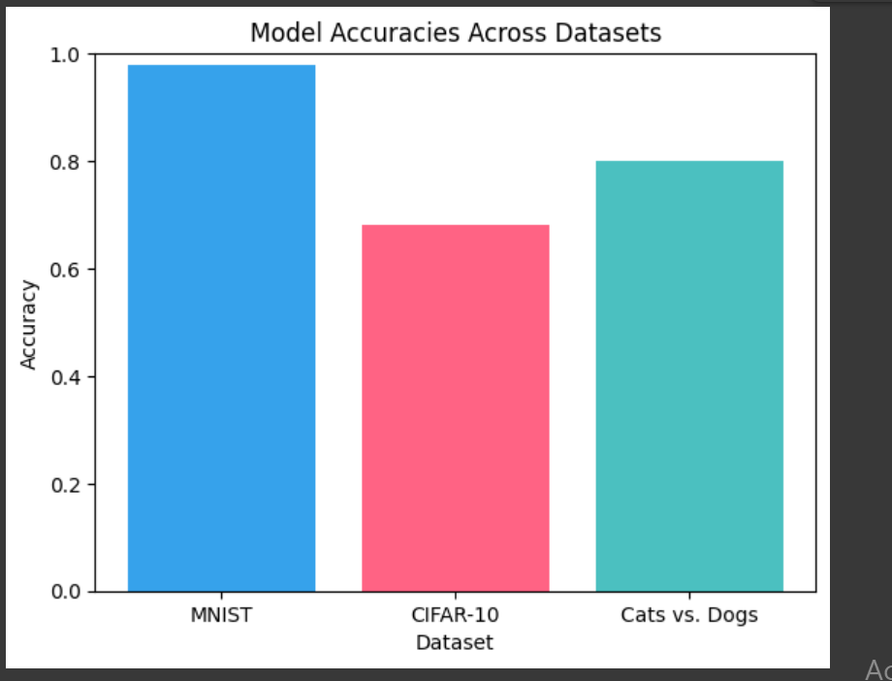
Results
MNIST Baseline CNN: ~98% accuracy.
CIFAR-10 CNN: ~68% accuracy.
Cats vs. Dogs MobileNetV2: ~78% accuracy after fine-tuning.

Slide 4
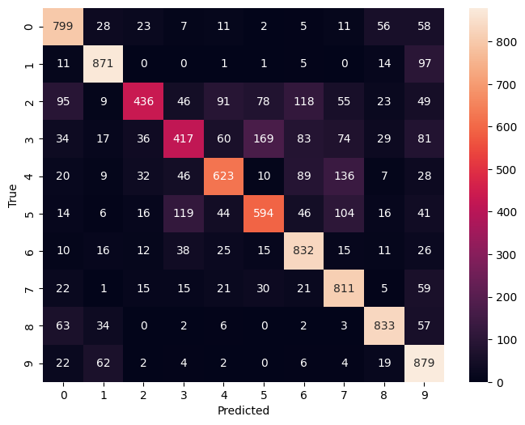
Evaluation & Insights
confusion matrix

Slide 5

Acknowledgments
Special thanks to:
- DevTown Community
- MSIT Student Chapter
- Google Developer Groups
- Mentors and participants

